Slide 1
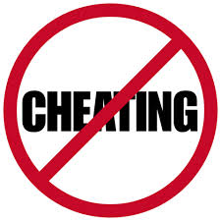
malpractices in examinations

Slide 2
MALPRACTICES: DEFINITION
Examination malpractices may be defined as all forms of cheating that may directly or indirectly falsify the ability of the students.
Malpractices are carried out inside or outside the examination hall.

Slide 3
WHY DO STUDENTS INDULGE IN MALPRACTICES DURING EXAMINATIONS?
What must be responsible for this first laziness on the part of today’s students might be a strong factor why people cheat during examination.
Negative peer pressure:Many people which have been caught cheating have attributed their actions to friends who lure them into engaging in the practice.
Students are not solely responsible for examination malpractices, ineffective and inadequate teaching on the part of teachers have also been adduced as a reason.

Slide 4
Lack of thorough and effective invigilation coupled with overcrowded examination halls can create room for students to cheat.
Not forgetting the roles of corrupt examination officers who leak question papers on the greasing of their palms.
Lastly but not the least is the role of parents who are supposed to be the embodiment of good virtues who encourage their children to cheat at examinations by purchasing leaked examination questions for them.

Slide 5
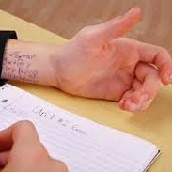
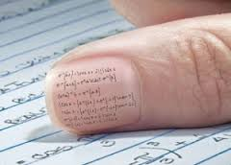

Slide 6
CHEATING WITHIN THE EXAMINATION ROOM:
Copying from one another, exchanging questions or answer sheets.
Bringing in prepared answers, copying from textbooks, notebooks, laboratory specimens or other instructional aids into the examination hall.
Collaboration with an invigilator/lecturer where it involves the lecturer providing written/oral answers to a student in the examination hall.

Slide 7
Oral/written communication between/amongst students.
Refusal to stop writing at the end of the examination.
Non-submission of answers scripts from the examination hall.
Illegal removal of answer scripts from the examination hall.
Manipulation of registration forms in order to sit for an examination for which the student is not qualified.

Slide 8
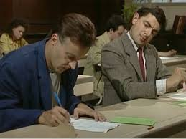
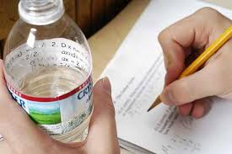

Slide 9
CHEATING OUTSIDE THE EXAMINATION HALL
Plagiarism is a form of examination malpractice and should be investigated and punished.
Plagiarism is the use of another person’s work without appropriate acknowledgement both in the next and in the references at the end.

Slide 10
Writing of projects, laboratory and/or field reports on behalf of a student by a member of staff.
Secretly breaking into staff office or departmental office in order to obtain question papers, answer scripts or marks sheets, or substituting a fresh answer script or the original script.
Colluding with a member of staff or any other person to obtain or on his own initiative obtaining set questions or answers before hand.

Slide 11
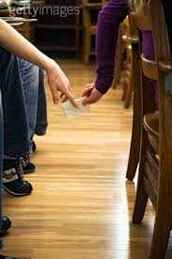
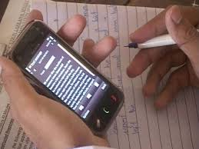

Slide 12
OTHER RELATED OFFENCES:
Producing a fake certificates
Assault and intimidation of the invigilator within or outside the examination hall.
Attempting to destroy and/or destroying evidence of examination malpractice.
Intimidation/threats to exhort sex/money/other favours from students by members of staff in exchange for grades.

Slide 13
EFFECTS OF EXAM MALPRACTICES:
A student who relies on cheating during examination cannot be useful to himself and the collection of people which indulge in examination malpractices cannot in any way help the country in addressing its infrastructural and developmental challenges.
Instead of being an asset, they will end up being a liability to the country.

Slide 14
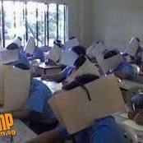
PREVENTION OF EXAM MALPRACTICES FOLLOWED IN SOME COUNTRIES

Slide 15
PREVENTION:
Examination halls for students must be very spacious to remove any form of temptation that might arise.
Both government and the private sector should ensure they employ qualified teachers who will be saddle with imparting knowledge to the students.
They should not promote students without the students possessing the requisite skills and knowledge

Slide 16
In addition, the government and the private sector involved in the provision of educational services should provide adequate learning aids which will go a long way in enhancing the performance of the students during examination.
The government should ensure that those caught in examination malpractices are not allowed to go Scot free to serve as deterrent for those who might be nursing the intention of cheating .

Slide 17
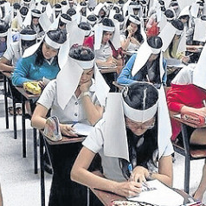
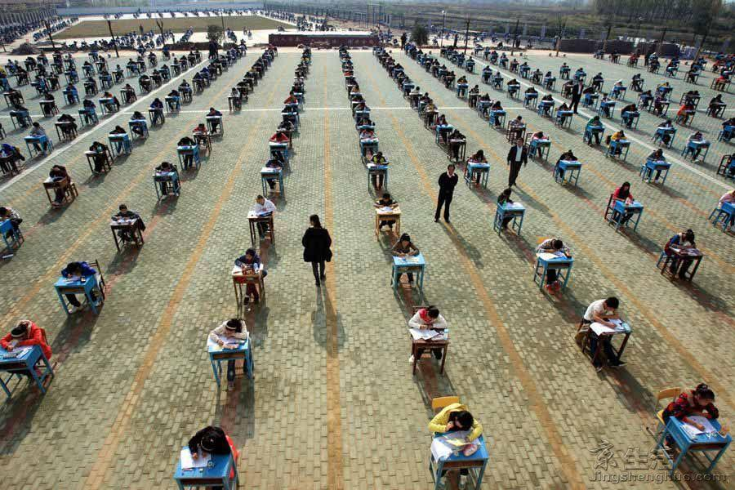

Slide 18


Slide 19


Slide 20
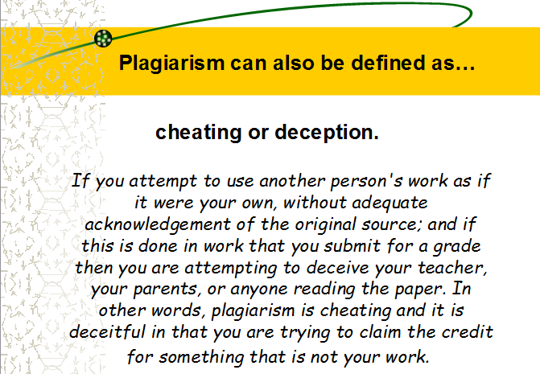

Slide 21
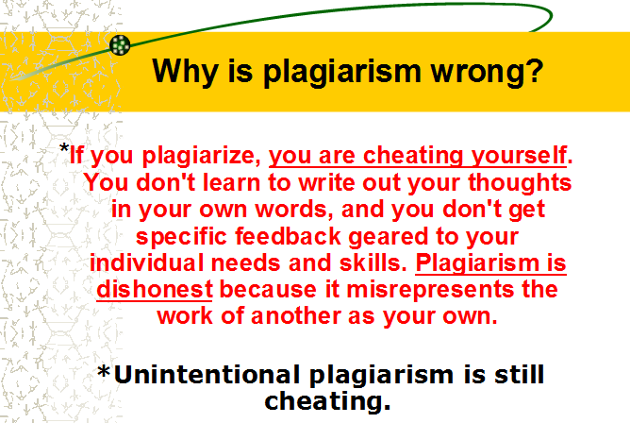

Slide 22
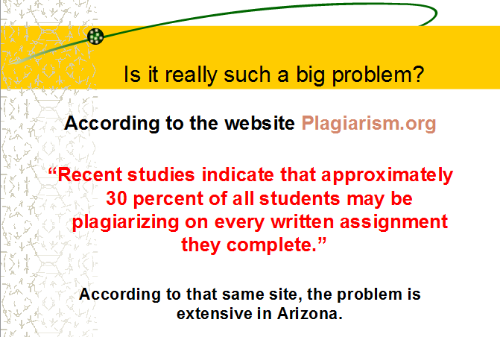

Slide 23
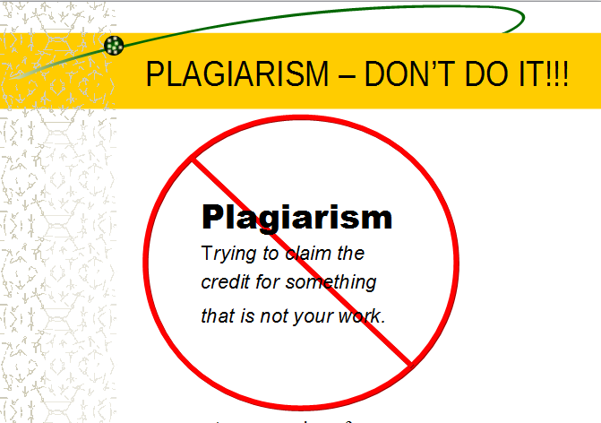

Slide 24
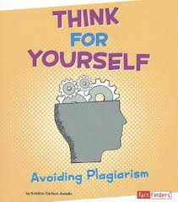

Slide 25


